Slide 1
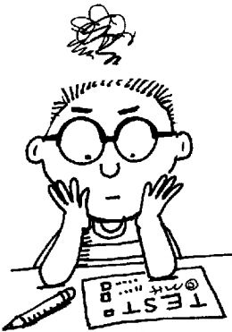
How to Take a Test

Slide 2
Success on tests is not luck…
or an accident…
or something that only the “smart kids” can achieve.
Success can be attained by everyone!

Slide 3
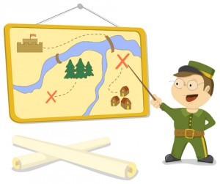
The key is having a strategy,
a tactic
or a plan of attack

Slide 4
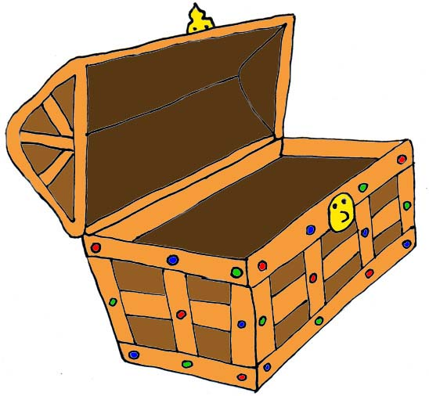
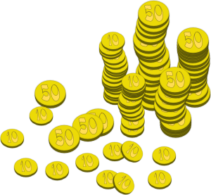
P.I.R.A.T.E.S.
In order to get our “treasure”, we are going
to have to solicit the help of…
100%
A+
100%
100%
A+
A+
A+
100%
A+
100%
A+
A+
100%
A+
A+
100%
A+
100%

Slide 5
P.I.R.A.T.E.S.
Step #1 P= prepare to succeed
Step #2 I= inspect the instructions
Step #3 R= read, remember, reduce
Step #4 A= answer or abandon
Step #5 T= turn back
Step #6 E= estimate
Step #7 S= survey

Slide 6
P= prepare to succeed
P = put “P.I.R.A.T.E.S., your name, date, and period on the test
A = allot time and order to the sections
S= say something positive
S= start within two minutes

Slide 7
I= inspect the instructions
R = read the instructions carefully
U = underline what and where to respond
N= notice special requirements

Slide 8
R= read, remember, reduce
Read the whole question
Remember using memory strategies
Reduce choices (also known as process of elimination)

Slide 9
A= answer or abandon
Answer the question if you are sure
or
Abandon the question, mark it with an * and return to it later if you’re not sure

Slide 10
T= turn back
Turn back to abandoned questions when you get to the end of the test
(Tell yourself this is how you will earn more points)

Slide 11
E= estimate
A = avoid absolutes
all, always, every, no, none, never and only
C = choose the longest or most detailed answer
E = eliminate identical choices

Slide 12
S= survey
Survey the entire test to ensure that all questions are answered
Switch answers only if you are sure (remember, your initial response is usually the right answer)

Slide 13
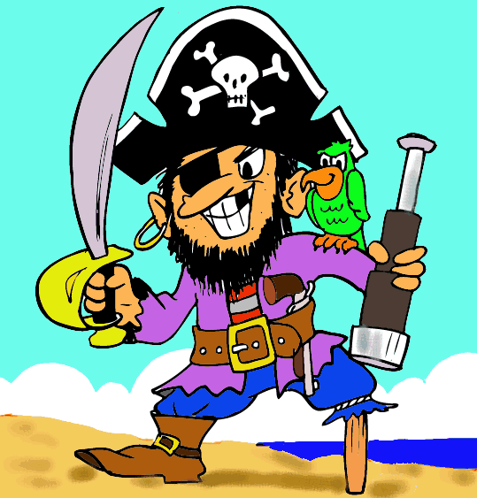
P. I. R. A. T. E. S.
If you act like pirates- pass and run, you will ace the test!
A+
100%
100%
A+
A+
100%

